Slide 1

Comparative Analysis of Convolutional Neural Networks (CNNs) for Deepfake Detection
By: Jeet Kumar

Slide 2
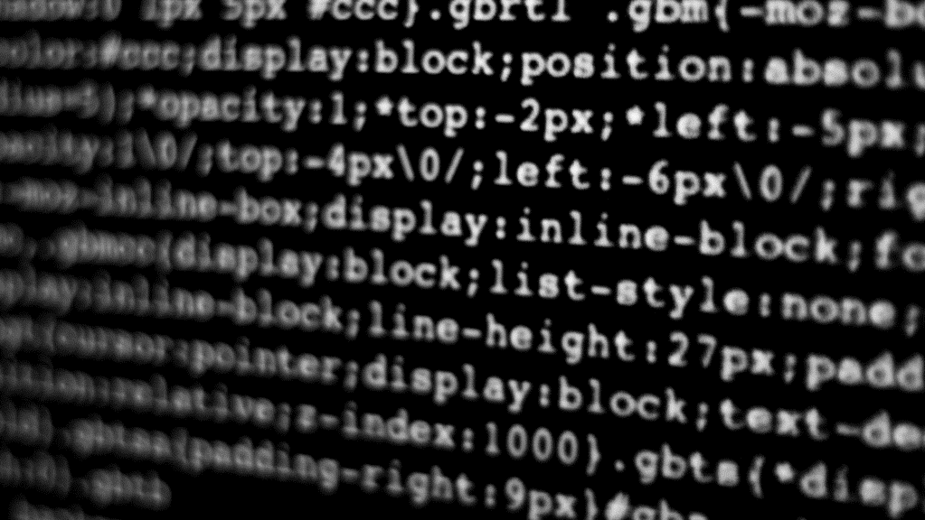
Introduction
Rise of AI-Generated Content
Threat To Society
Convolutional Neural Networks (CNNs)
2

Slide 3

Questions
Assessment
Measure Efficacy
Differences in Performance
3

Slide 4
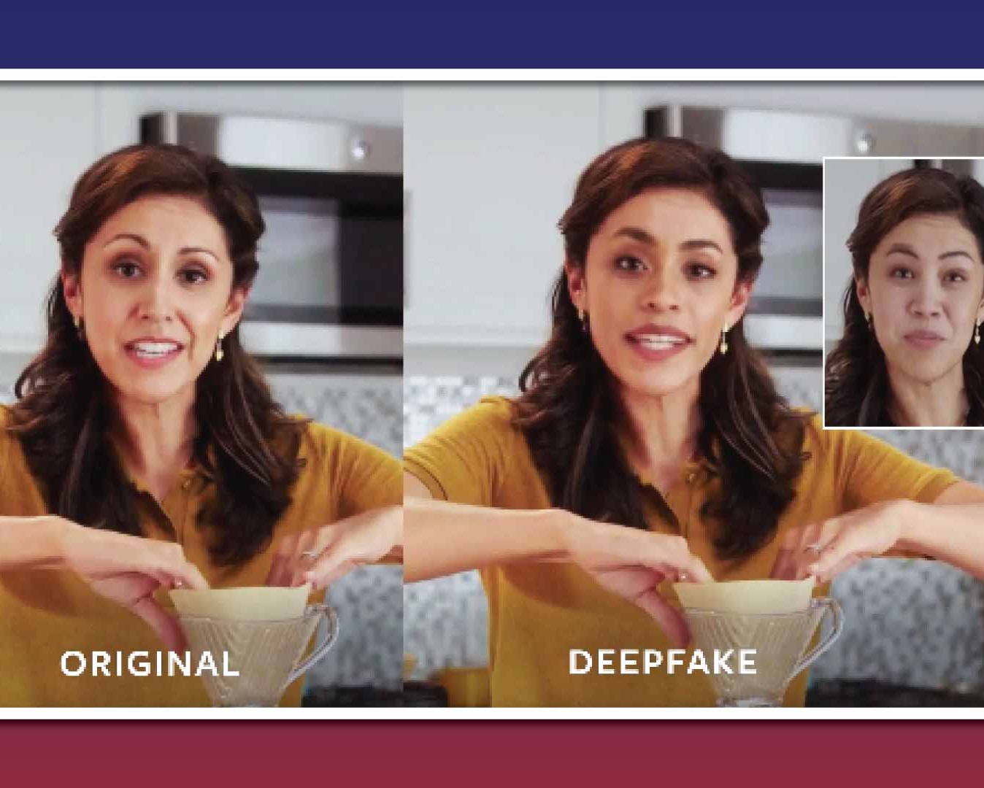
Assumptions
FaceForensics++, forensics dataset (Rossler, 2019)
Comparable
Efficacy
Architecture
Scaling
4

Slide 5
Methodology
FaceForensics++ Database
Preprocessing
Preparing
CNN Model
Output
Input Layer
Convolutional Layer
Pooling Layer
Fully Connected Layers
5

Slide 6
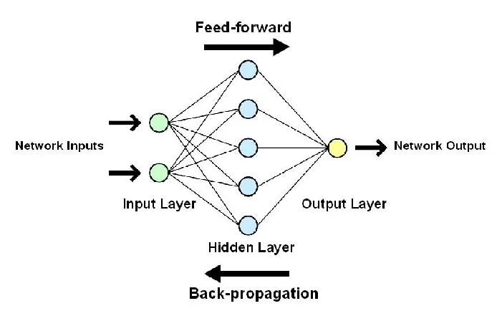
Proposed Solution
Comparison for efficacy
ResNet50 and EfficientNetV2B0
Performance Metrics
Training
Accuracy
Loss
Validation
Accuracy
Loss
Training time
6

Slide 7
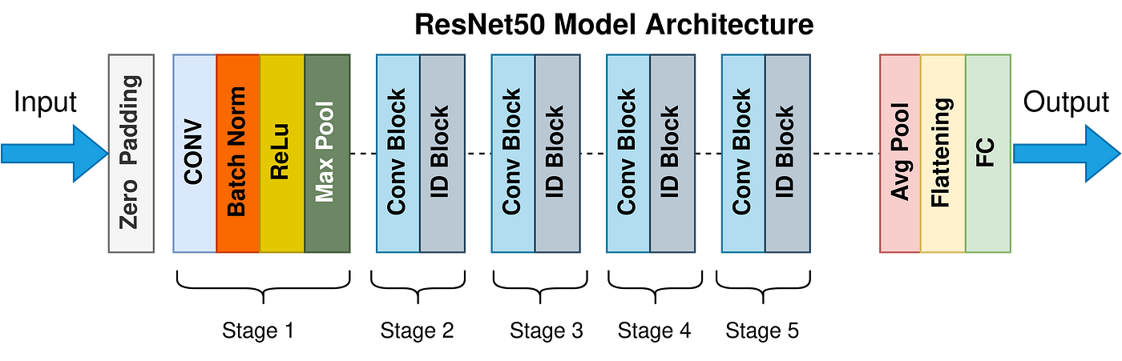
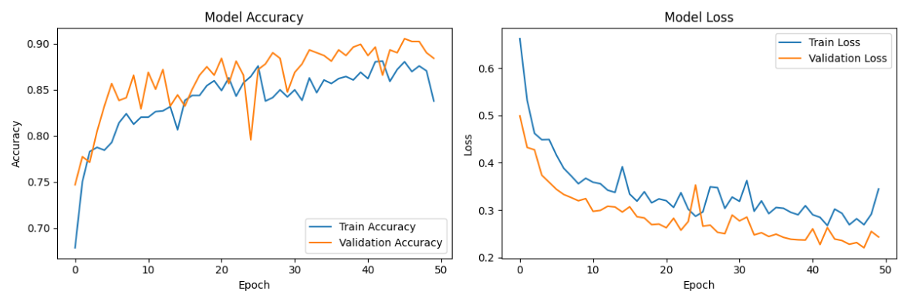
ResNet50 Model
Fixed depth of 50 layers
Residual blocks and skip connections
7

Slide 8
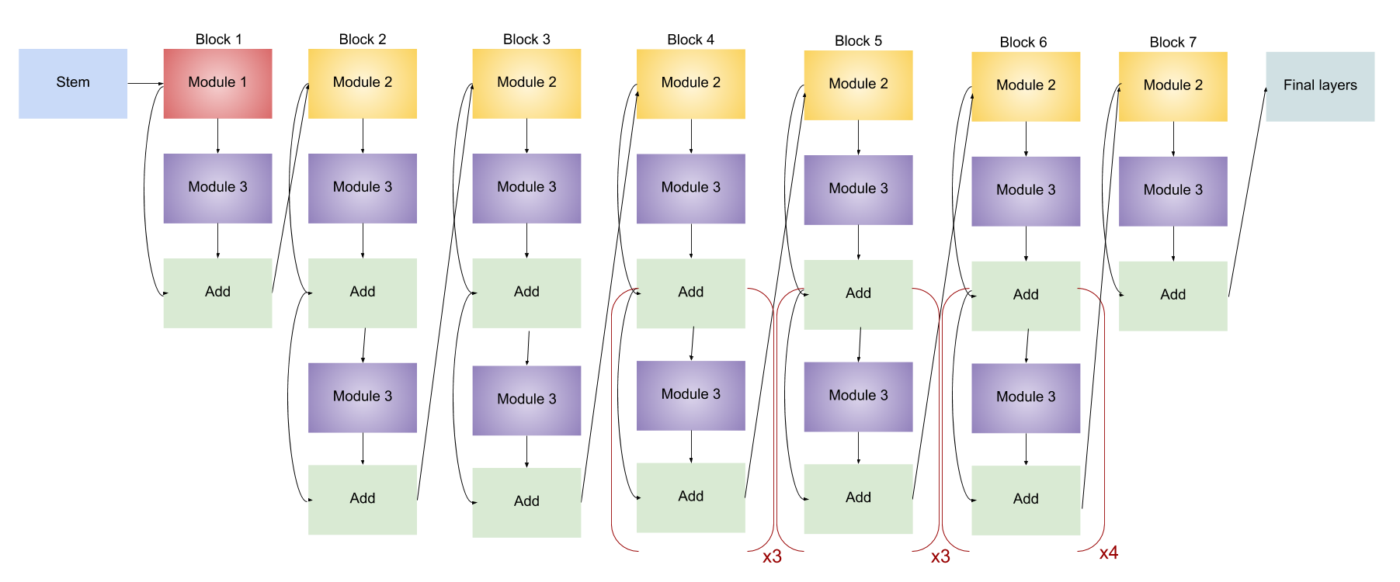
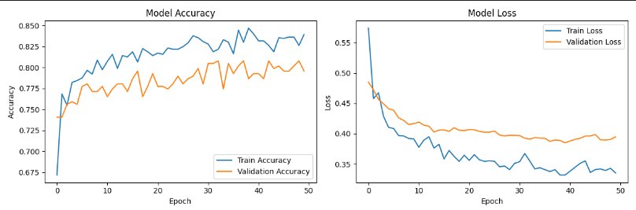
EfficientNetV2B0
Lightweight architecture and depth-wise convolutions
Less parameters enabling efficiency
8

Slide 9
Results
9
Model | Parameters | Final Validation Accuracy | Training Time per Epoch
ResNet50 | 23M | 88.41% | 45 secs
EfficientNetV2B0 | 5.9M | 79.57% | 15 secs

Slide 10

Challenges
Model scalability
Evaluation metrics
Control of variables
10

Slide 11

FINAL TAKEAWAYS
ResNet50 achieved a higher accuracy with higher computational demand
Refine parameters
Potential for hybrid approaches
11

Slide 12

THANK YOU

